Slide 1
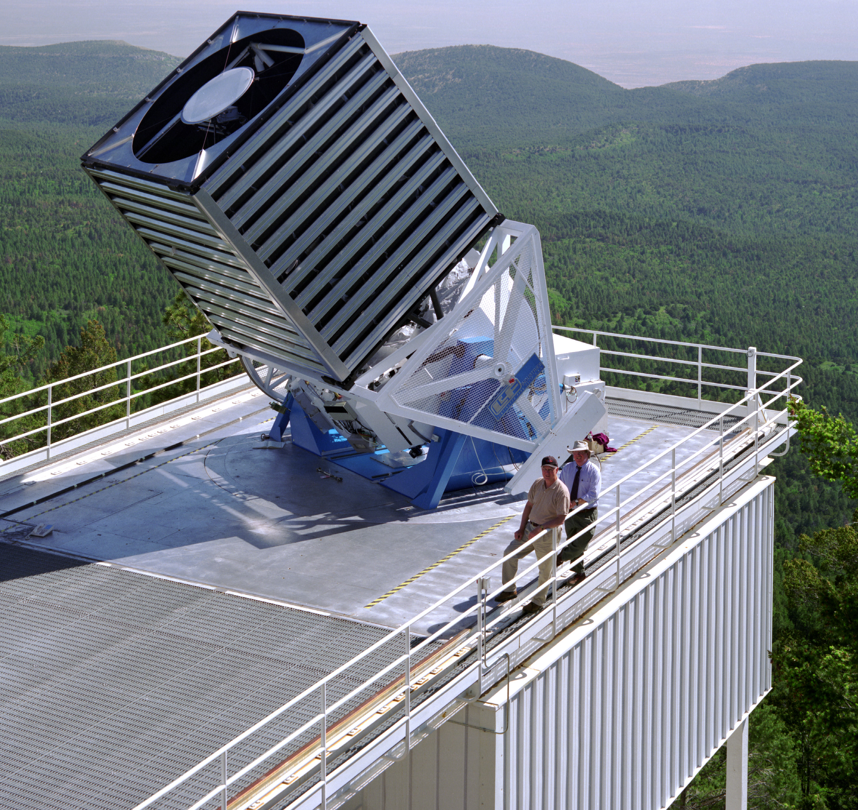
Cosmological Measurements from Angular Power Spectra Analysis of BOSS DR12 Tomography
https://arxiv.org/abs/1809.07204

Slide 2
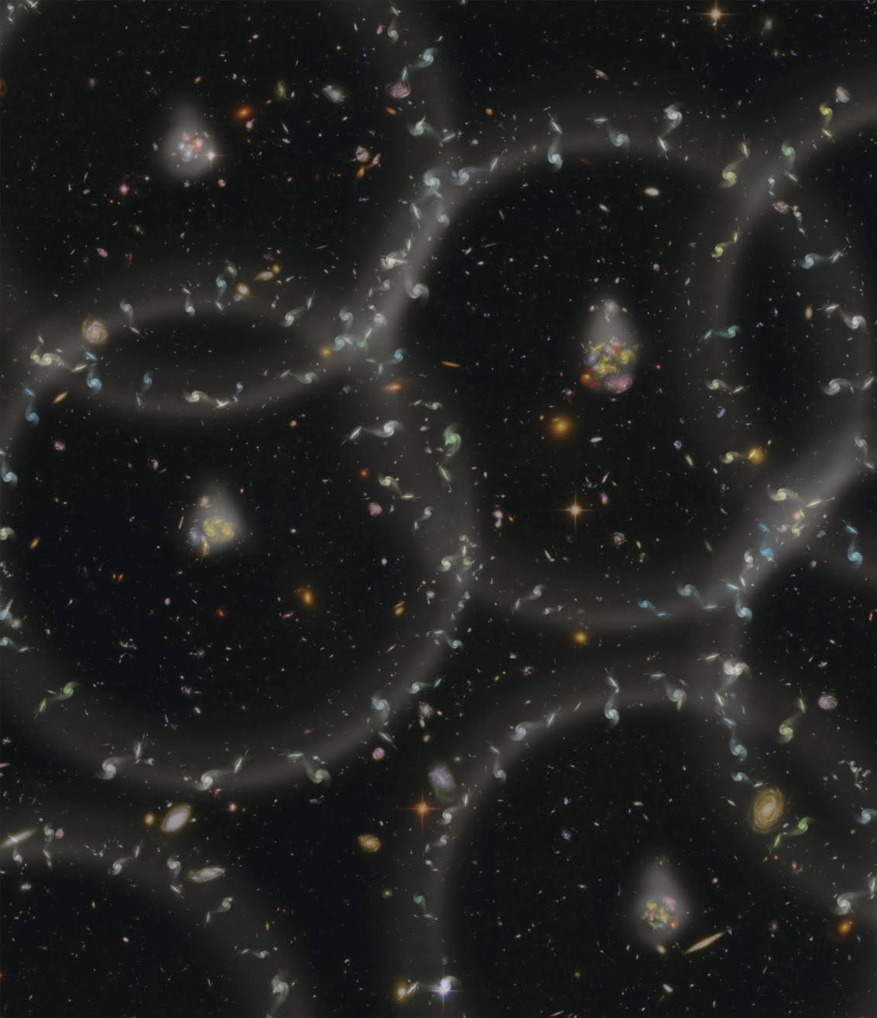
BOSS Dr12 data
https://arxiv.org/abs/1809.07204

Slide 3
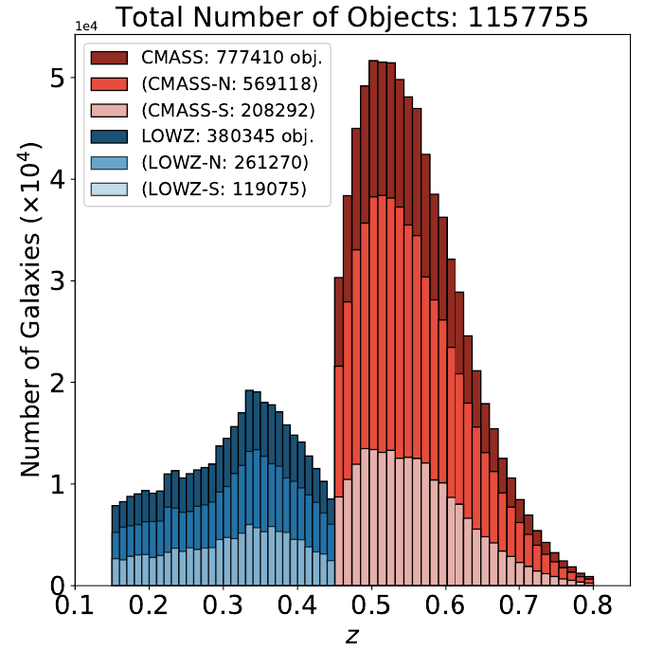
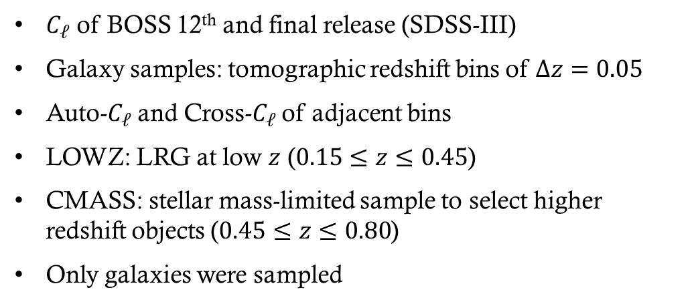
introduction
$C_{ℓ}$ of BOSS 12th and final release (SDSS-III)
Galaxy samples: tomographic redshift bins of $Δz=0.05$
Auto-$C_{ℓ}$ and Cross-$C_{ℓ}$ of adjacent bins
LOWZ: LRG at low $z$ ($0.15≤z≤0.45$)
CMASS: stellar mass-limited sample to select higher redshift objects ($0.45≤z≤0.80$)
Only galaxies were sampled

Slide 4
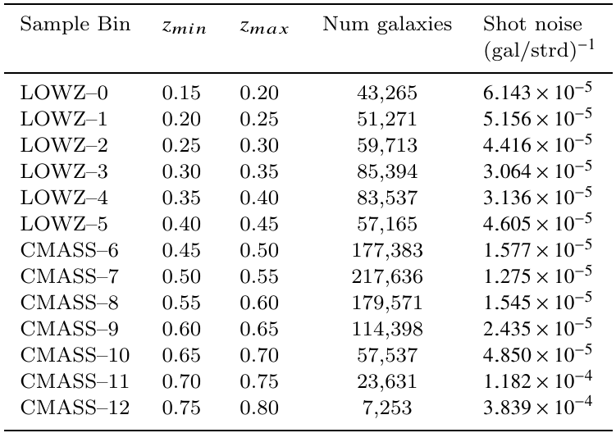
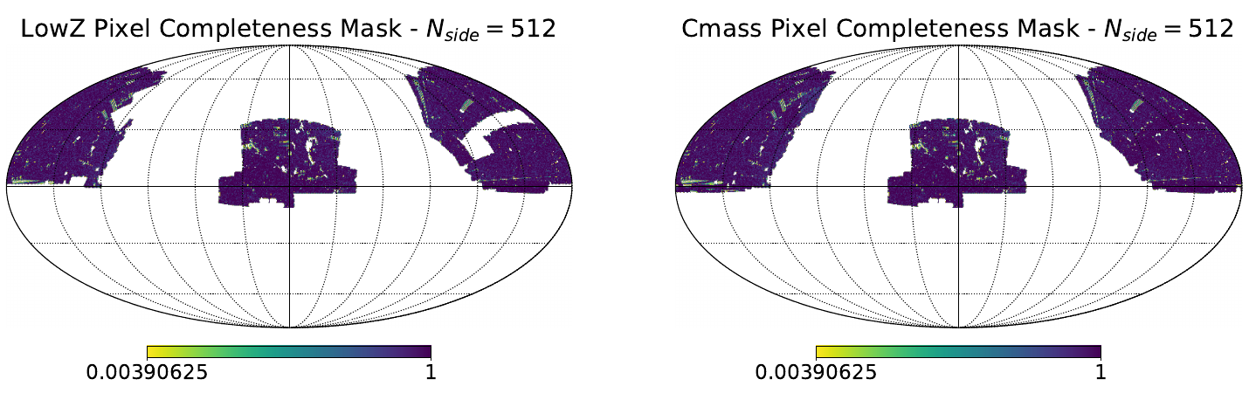
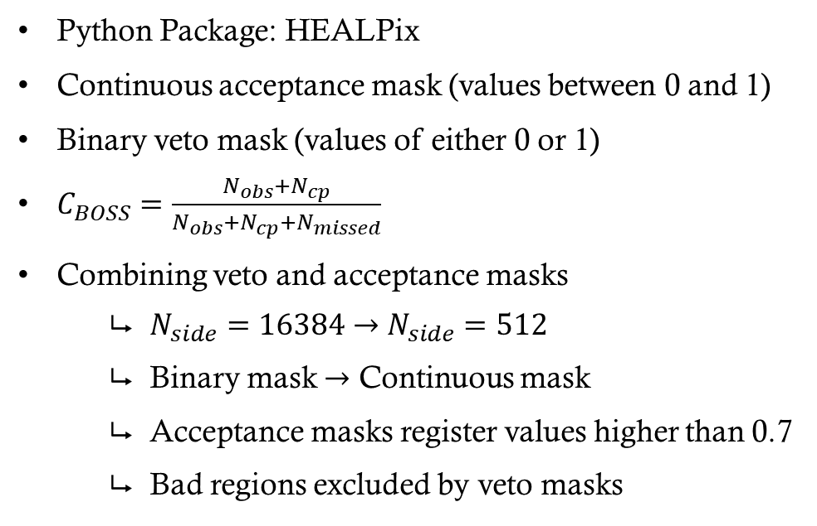
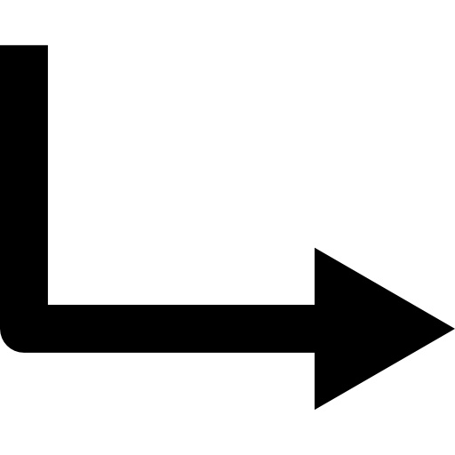
Masks
Python Package: HEALPix
Continuous acceptance mask (values between 0 and 1)
Binary veto mask (values of either 0 or 1)
$C_{BOSS}=\frac{N_{obs}+N_{cp}}{N_{obs}+N_{cp}+N_{missed}}$
Combining veto and acceptance masks
$N_{side}=16384$ $→$ $N_{side}=512$
Binary mask $→$ Continuous mask
Acceptance masks register values higher than 0.7
Bad regions excluded by veto masks

Slide 5
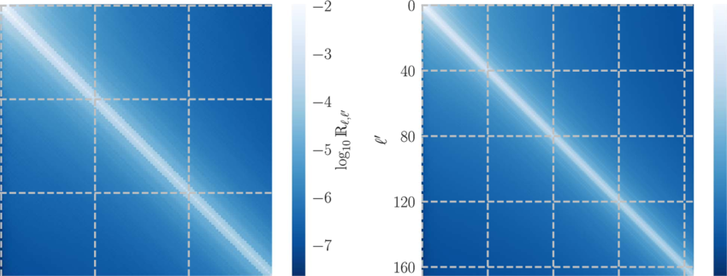
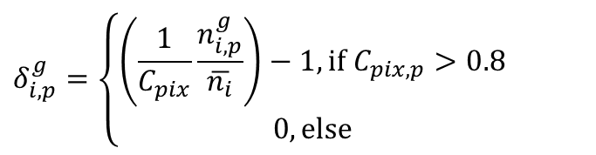
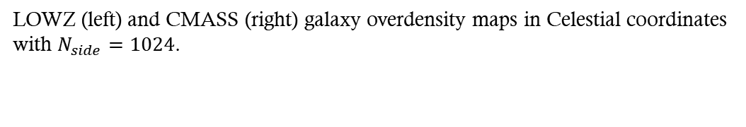
Overdensity maps
$$δ_{i,p}^{g}=\left\{\begin{aligned}\left(\frac{1}{C_{pix}}\frac{n_{i,p}^{g}}{\overline{n_{i}}}\right)−1, \text{if} C_{pix,p}>0.8 \\ 0, \text{else}\end{aligned}\right.$$
LOWZ (left) and CMASS (right) galaxy overdensity maps in Celestial coordinates with $N_{side}=1024$.

Slide 6

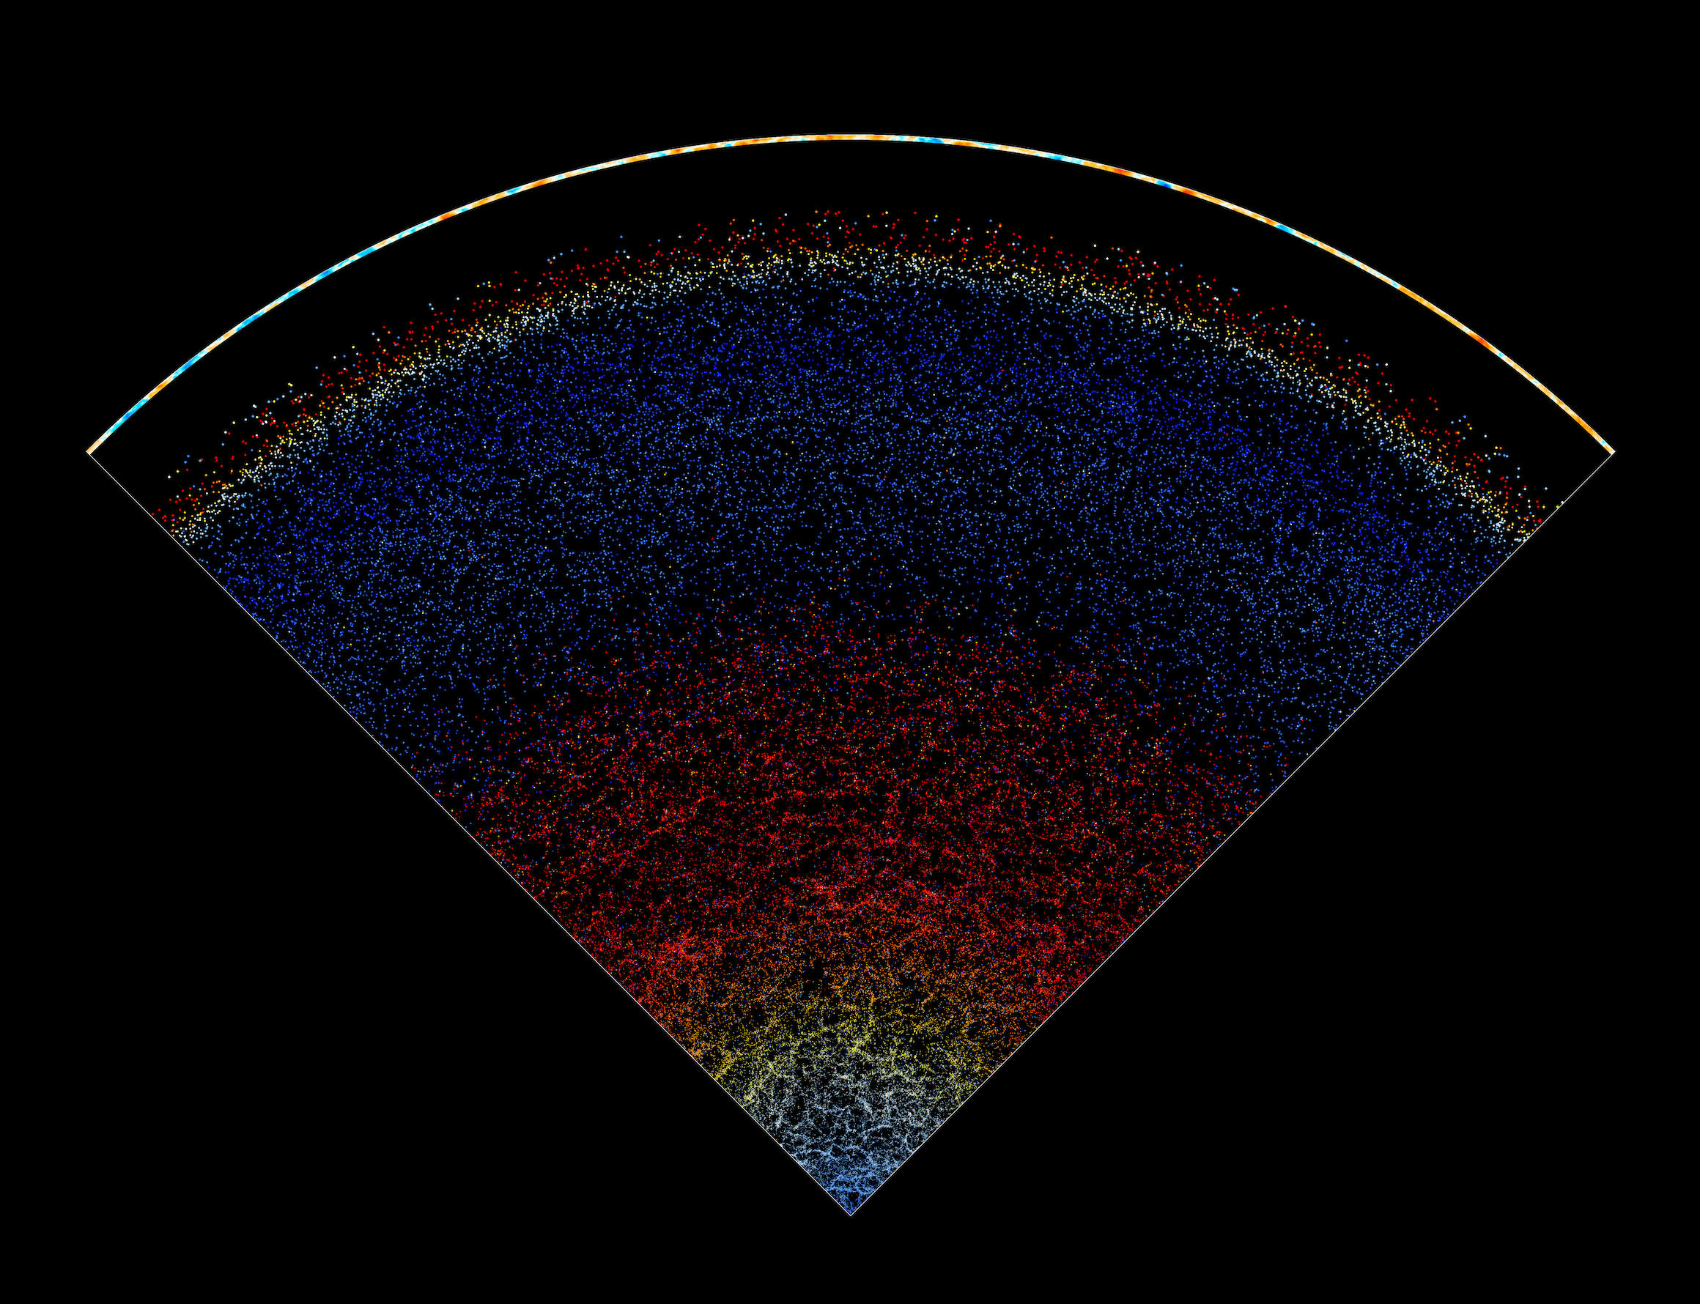
Angular power spectra estimators and measurements
https://arxiv.org/abs/1809.07204

Slide 7
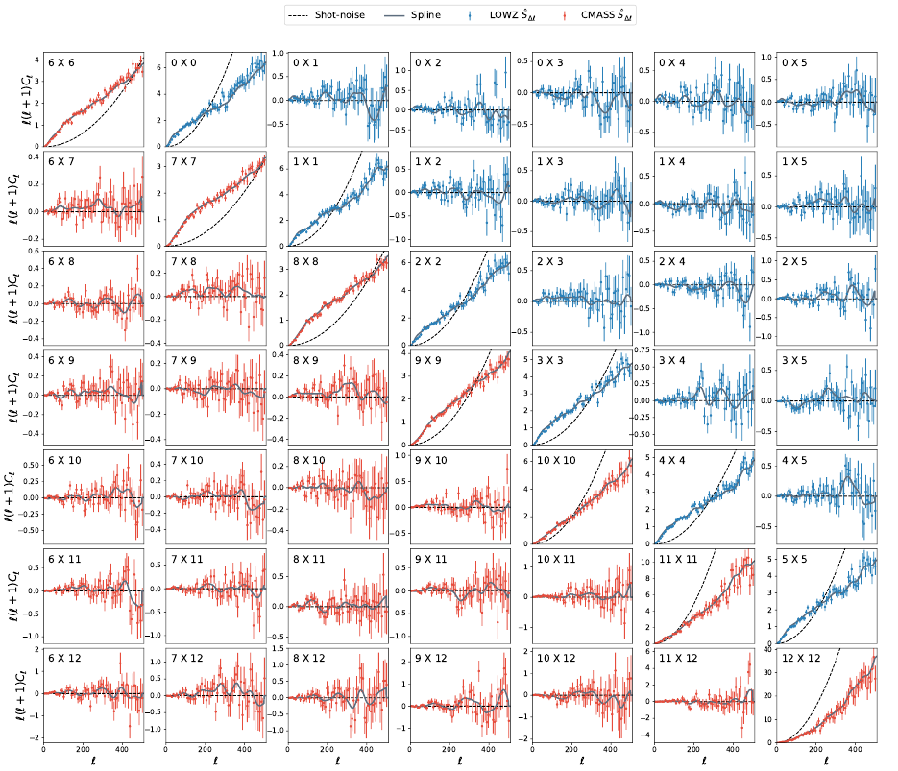
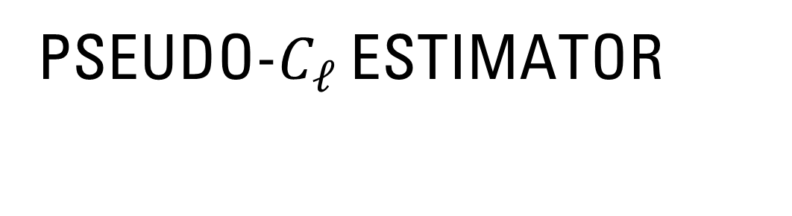
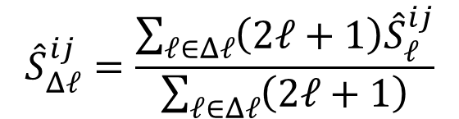
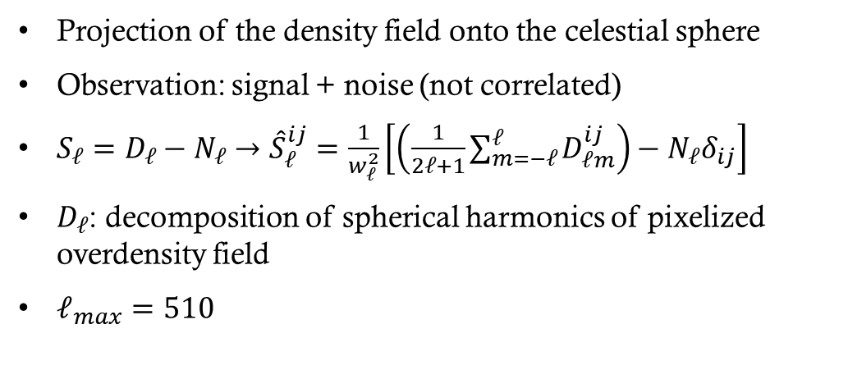
Pseudo-$C_{ℓ}$ estimator
Projection of the density field onto the celestial sphere
Observation: signal + noise (not correlated)
$S_{ℓ}=D_{ℓ}−N_{ℓ}→{\hat{S}}_{ℓ}^{ij}=\frac{1}{w_{ℓ}^{2}}\left[\left(\frac{1}{2ℓ+1}\sum_{m=−ℓ}^{ℓ}{D_{ℓm}^{ij}}\right)−N_{ℓ}δ_{ij}\right]$
$D_{ℓ}$: decomposition of spherical harmonics of pixelized overdensity field
$ℓ_{max}=510$
$${\hat{S}}_{Δℓ}^{ij}=\frac{\sum_{ℓ∈Δℓ}{\left(2ℓ+1\right){\hat{S}}_{ℓ}^{ij}}}{\sum_{ℓ∈Δℓ}{\left(2ℓ+1\right)}}$$

Slide 8
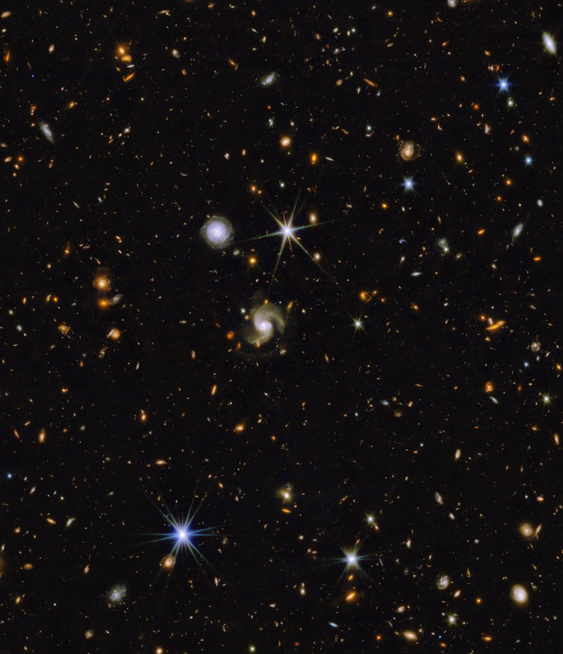
MODELLING OF THEORY AND ESTIMATION OF COVARIANCE MATRICES
https://arxiv.org/abs/1809.07204

Slide 9
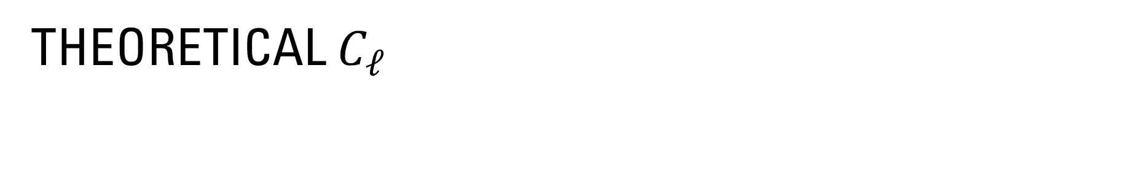
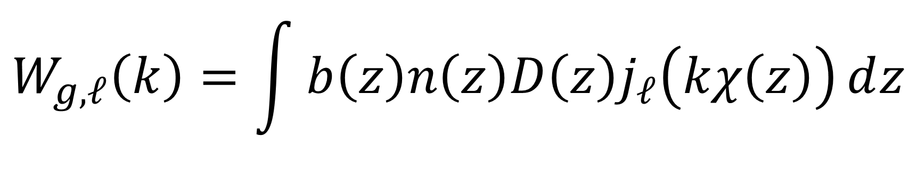
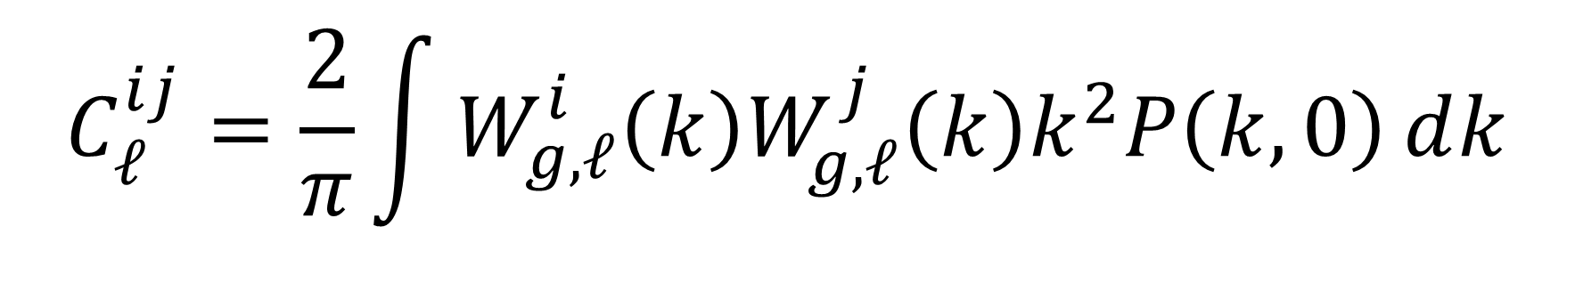
Theoretical $C_{ℓ}$
$$C_{ℓ}^{ij}=\frac{2}{π}\int{W_{g,ℓ}^{i}\left(k\right)W_{g,ℓ}^{j}\left(k\right)k^{2}P\left(k,0\right)ⅆk}$$
$$W_{g,ℓ}\left(k\right)=\int{b\left(z\right)n\left(z\right)D\left(z\right)j_{ℓ}\left(kχ\left(z\right)\right)ⅆz}$$

Slide 10
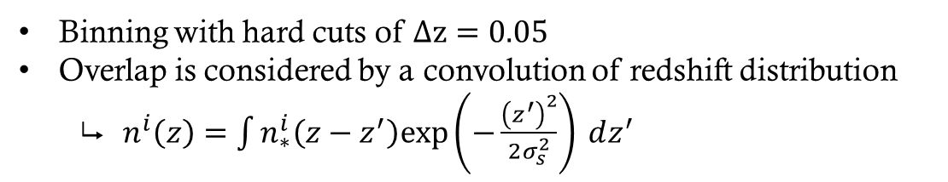
spectroscopic redshift
Binning with hard cuts of $Δz=0.05$
Overlap is considered by a convolution of redshift distribution
$n^{i}\left(z\right)=\int{n_{∗}^{i}\left(z−z^{′}\right)\text{exp}\left(−\frac{{\left(z^{′}\right)}^{2}}{2σ_{s}^{2}}\right) ⅆz^{′}}$

Slide 11
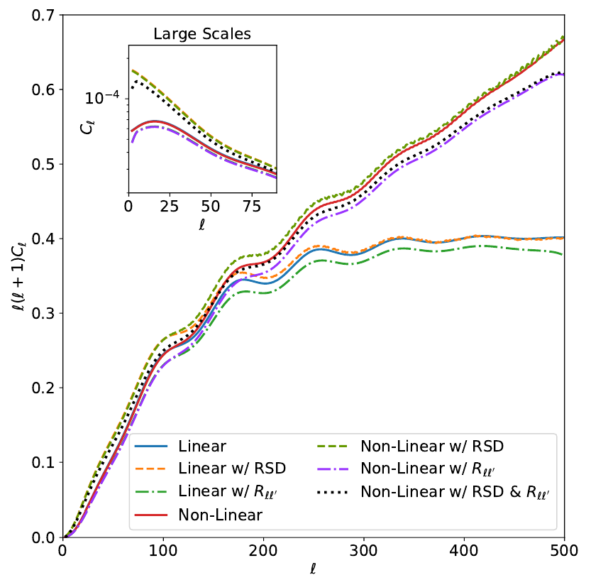
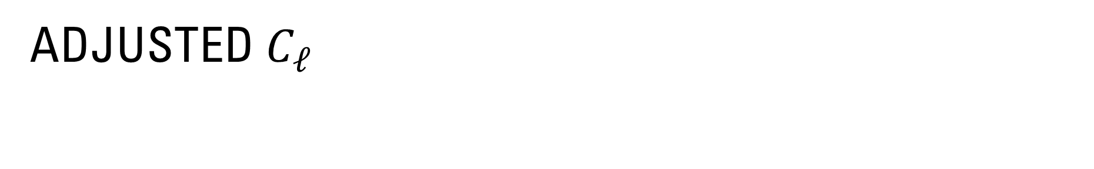
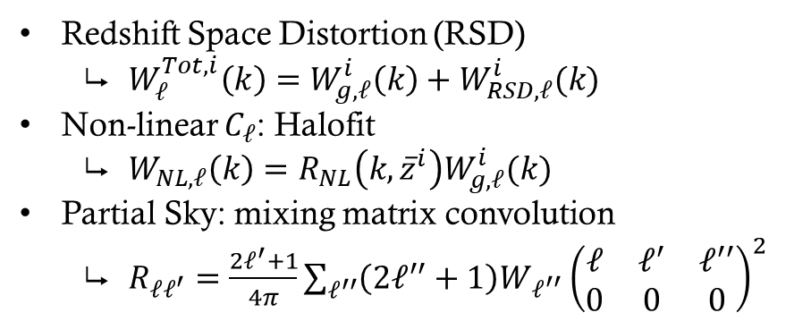
Adjusted $C_{ℓ}$
Redshift Space Distortion (RSD)
$W_{ℓ}^{Tot,i}\left(k\right)=W_{g,ℓ}^{i}\left(k\right)+W_{RSD,ℓ}^{i}(k)$
Non-linear $C_{ℓ}$: Halofit
$W_{NL,ℓ}\left(k\right)=R_{NL}\left(k,{\overline{z}}^{i}\right)W_{g,ℓ}^{i}(k)$
Partial Sky: mixing matrix convolution
$R_{ℓℓ^{′}}=\frac{2ℓ^{′}+1}{4π}\sum_{ℓ^{′′}}{\left(2ℓ^{′′}+1\right)W_{ℓ^{′′}}{\left(\begin{matrix}ℓ & ℓ^{′} & ℓ^{′′} \\ 0 & 0 & 0\end{matrix}\right)}^{2}}$

Slide 12
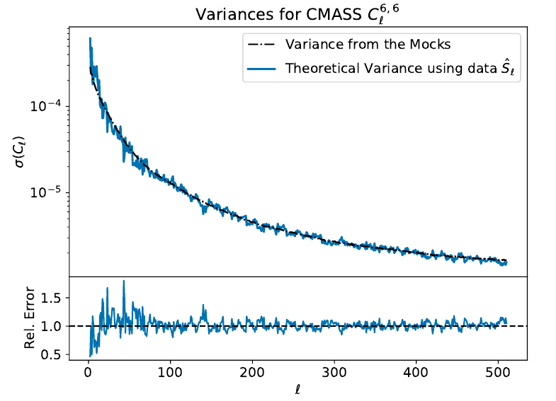
Log-normal mocks
Covariance Matrix needed to constrain cosmological parameters
Estimation through galaxy clustering
Cosmology
Systematic effects
Observational effects
Mocks generated by FLASK
6000 log-normal mocks for each sample

Slide 13
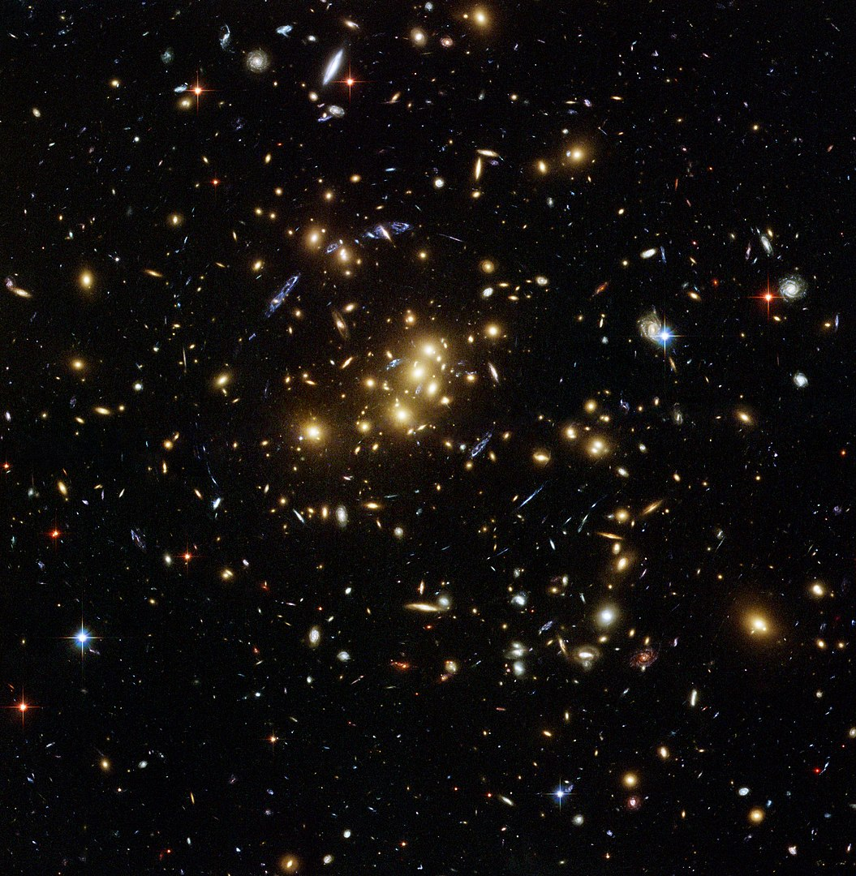
Systematics tests and cosmological analysis
https://arxiv.org/abs/1809.07204

Slide 14
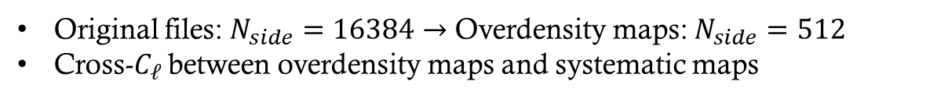
Systematics maps
Original files: $N_{side}=16384→$ Overdensity maps: $N_{side}=512$
Cross-$C_{ℓ}$ between overdensity maps and systematic maps

Slide 15
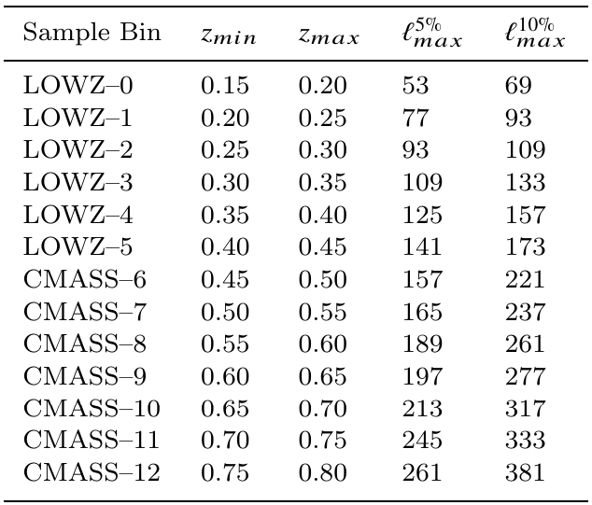
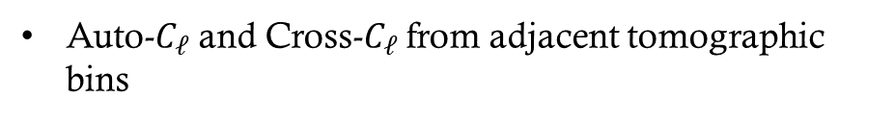
Cosmological analysis
Auto-$C_{ℓ}$ and Cross-$C_{ℓ}$ from adjacent tomographic bins

Slide 16
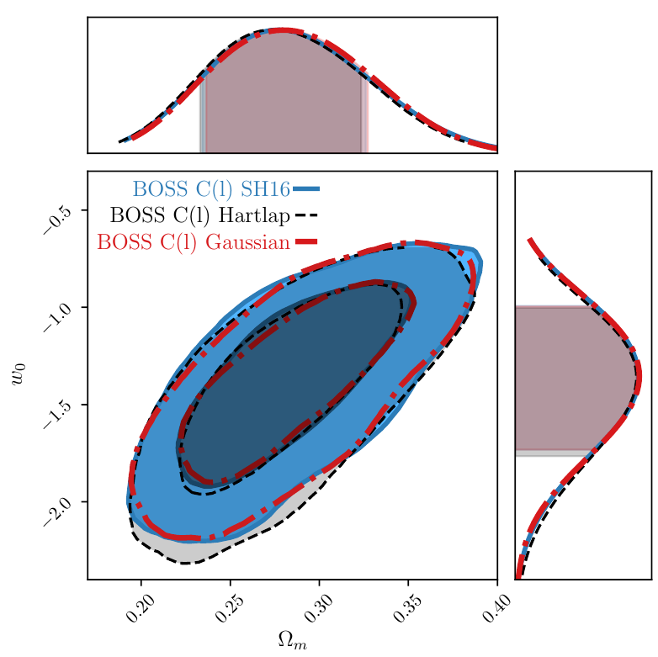
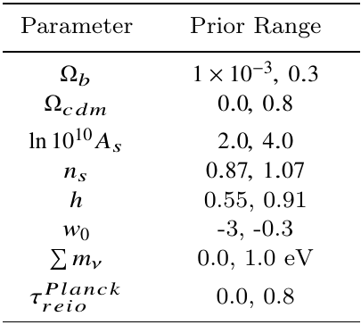
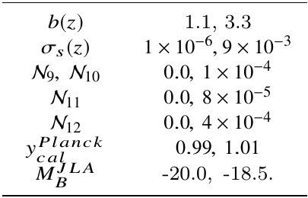
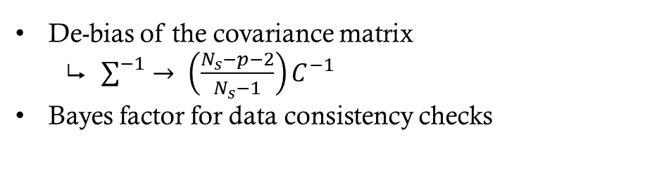
Likelihoods, priors & bayes factor
De-bias of the covariance matrix
$\sum^{−1}{→ \left(\frac{N_{s}−p−2}{N_{s}−1}\right)C^{−1}}$
Bayes factor for data consistency checks

Slide 17
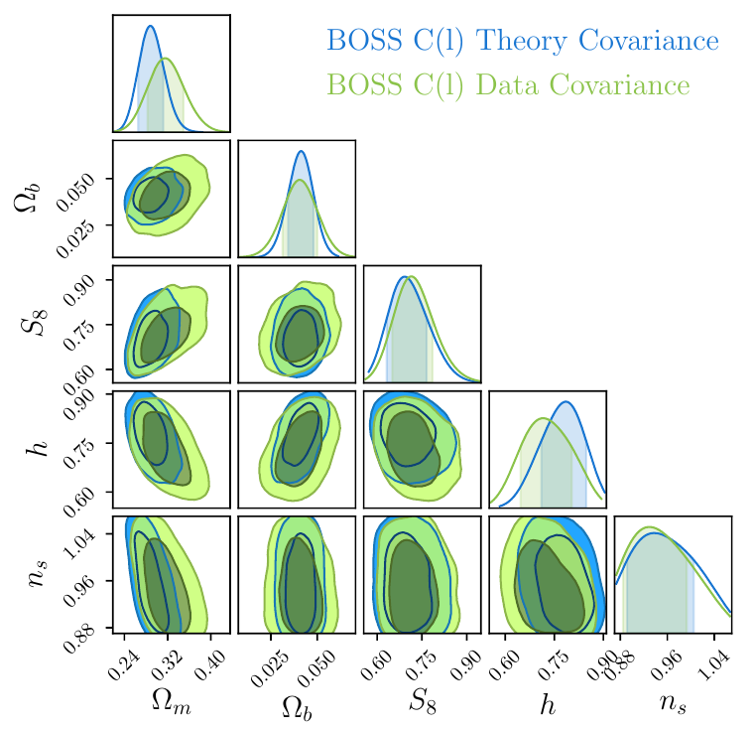
Likelihoods, priors & bayes factor
De-bias of the covariance matrix
$\sum^{−1}{→ \left(\frac{N_{s}−p−2}{N_{s}−1}\right)C^{−1}}$
Bayes factor for data consistency checks

Slide 18
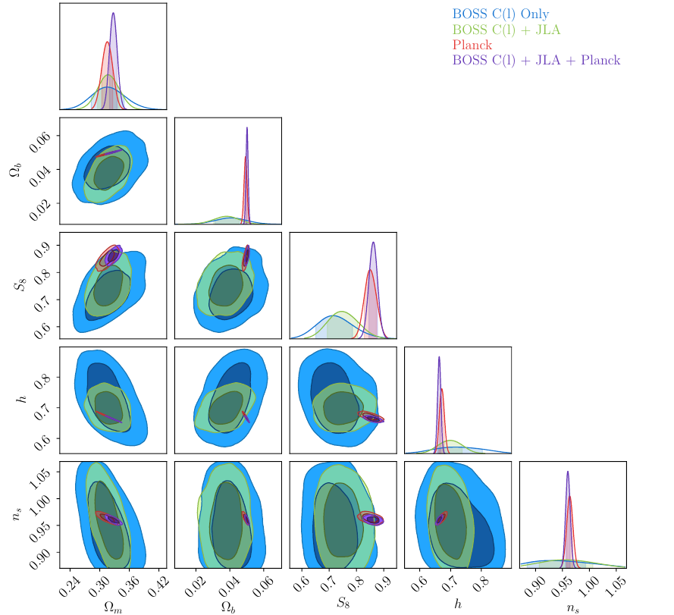
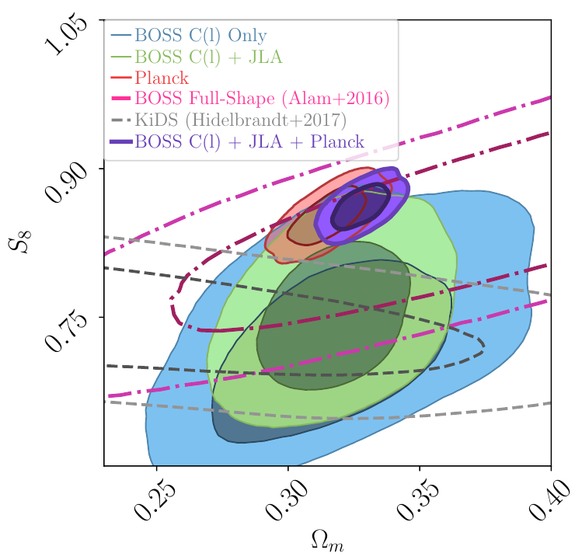
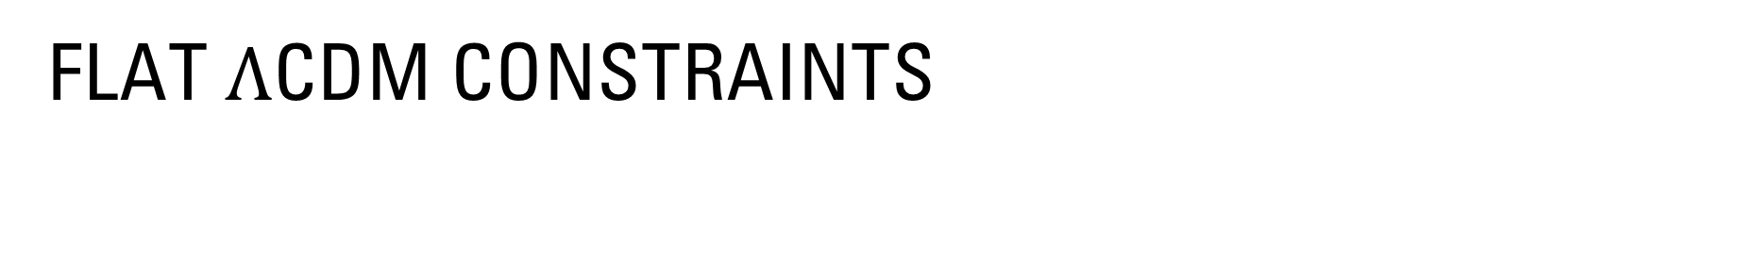
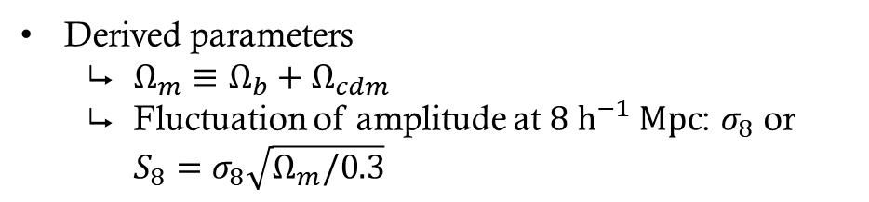
Flat $Λ$CDM constraints
Derived parameters
$Ω_{m}≡Ω_{b}+Ω_{cdm}$
Fluctuation of amplitude at $8 {\text{h}}^{−1} \text{Mpc}$: $σ_{8}$ or $S_{8}=σ_{8}\sqrt{Ω_{m}/0.3}$

Slide 19
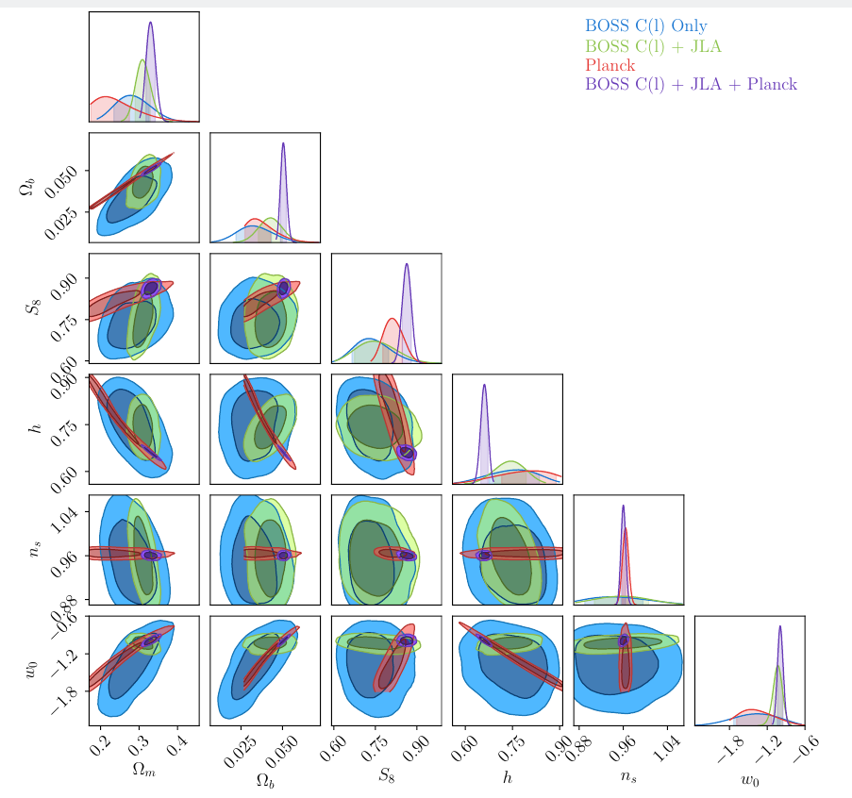
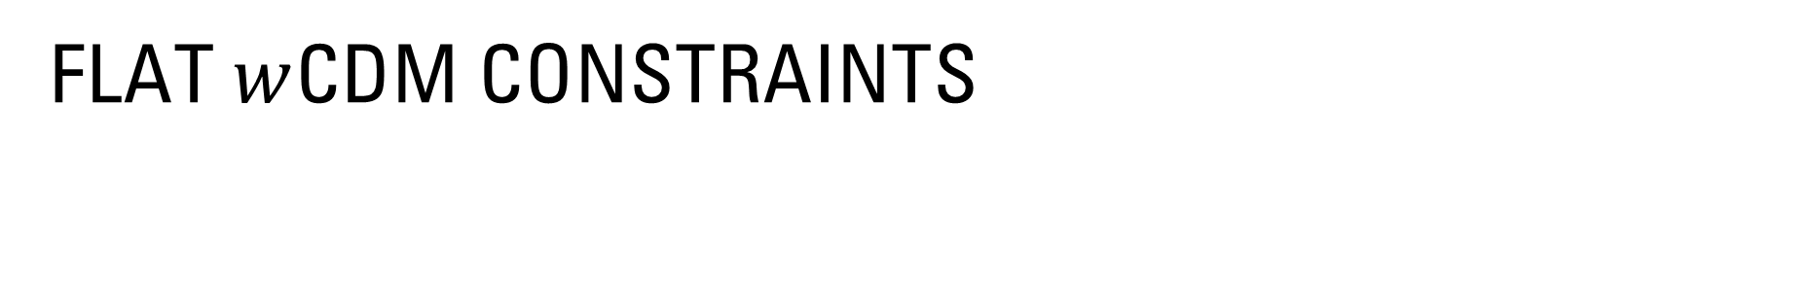
Flat $w$cDM constraints

Slide 20
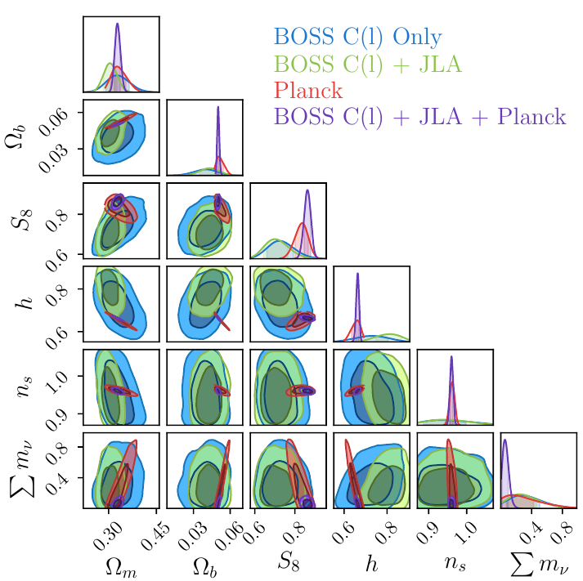
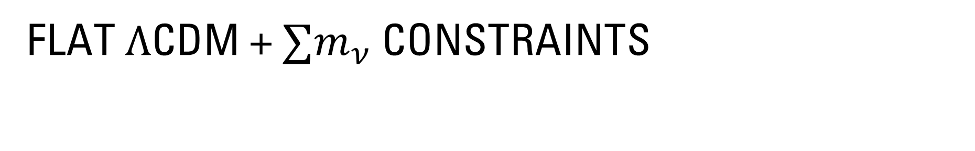
Flat $Λ$cDM + $∑m_{ν}$ constraints

Slide 21
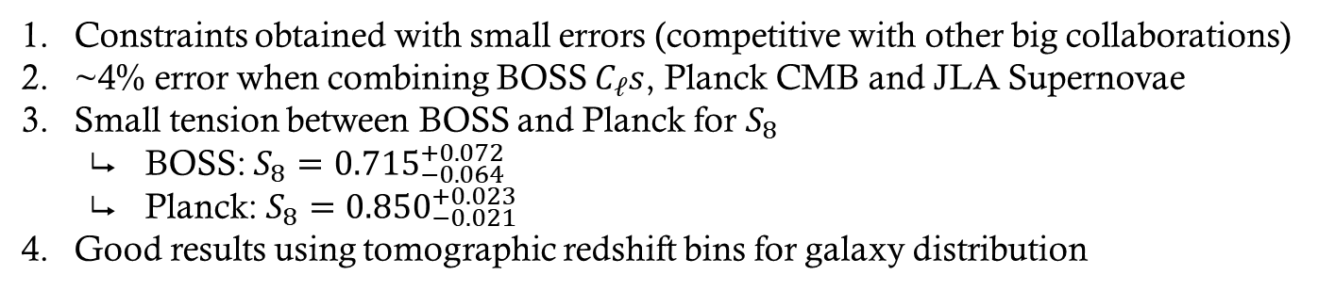
Main conclusions
Constraints obtained with small errors (competitive with other big collaborations)
~4% error when combining BOSS $C_{ℓ}s$, Planck CMB and JLA Supernovae
Small tension between BOSS and Planck for $S_{8}$
BOSS: $S_{8}={0.715}_{−0.064}^{+0.072}$
Planck: $S_{8}={0.850}_{−0.021}^{+0.023}$
Good results using tomographic redshift bins for galaxy distribution

Slide 22
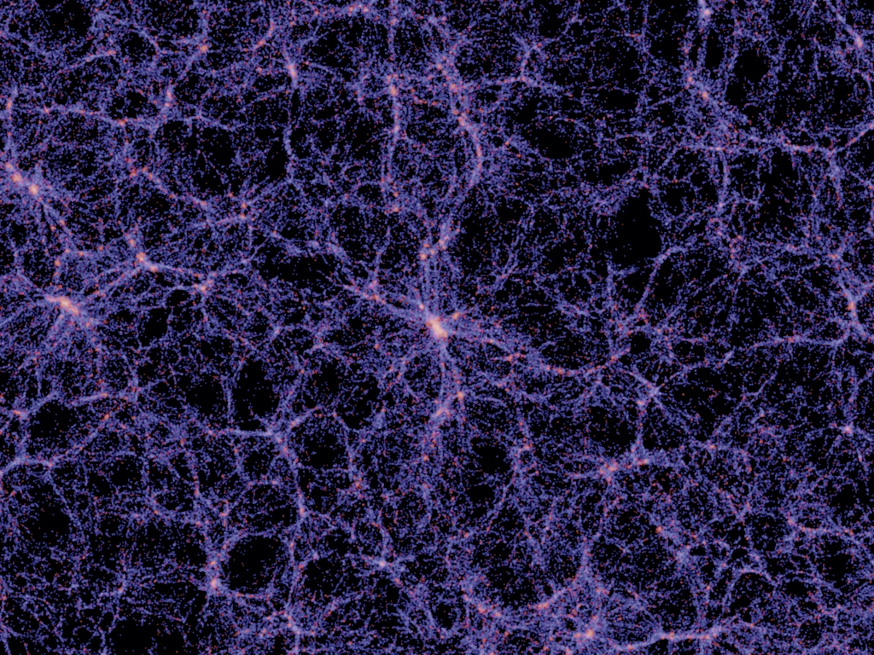
Thank you

